Slide 1
Hautbois Activity Centre
Residential 2023-2024 Information Meeting
31st October 2023
Notes:
We are going to focus on ratio more than proportion today.
First, let’s recap!
Independently on your whiteboards

Slide 2
Residential Details:
Where:
Hautbois (Pronounced: Oo-bwa) Activity Centre in Norwich
When:
25th June – 28th June (4 days and 3 nights)
Who:
Class 3 pupils
Mrs Johnson
Mr O’Sullivan
Mrs Allen (possibly)
Notes:
We are going to focus on ratio more than proportion today.
First, let’s recap!
Independently on your whiteboards

Slide 3
Residential Details:
How:
Travelling by coach
Accommodation:
Reedcutters Village
Food:
Full Board Catering
Activities:
To be Confirmed
Evening Activities:
Games Night; Movie Night; Disco Night
Notes:
We are going to focus on ratio more than proportion today.
First, let’s recap!
Independently on your whiteboards

Slide 4
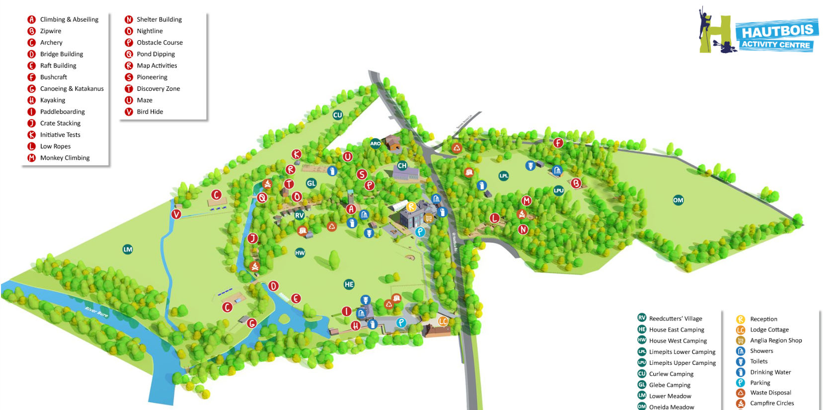
Map of Hautbois Activity Centre:
https://www.hautbois.org.uk/interactive-map/
Notes:
We are going to focus on ratio more than proportion today.
First, let’s recap!
Independently on your whiteboards

Slide 5
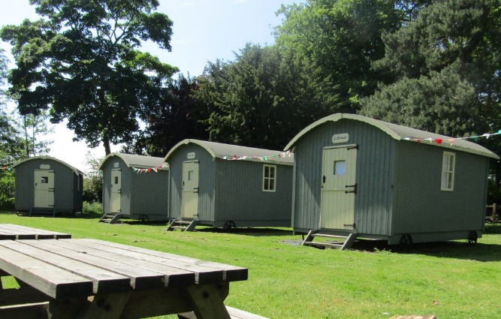
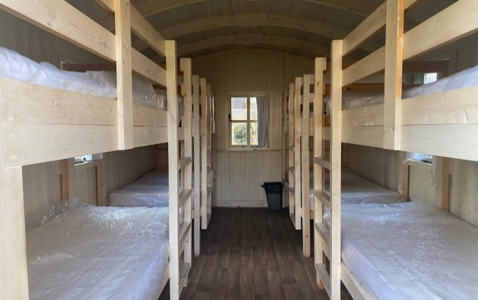
Reedcutters Village:
Accommodation - Reedcutters’ Cabins:
The Reedcutters’ Village has six 8-bed cabins (that looks like wagons), one 6-bed cabin and one 4-bed cabin.
In six of the huts, there are four bunks (eight beds). Each cabin has space to stow your bags and to hang waterproofs.
Both the 6-bed and 4-bed cabins can be divided into two separate rooms, suitable for group leaders. These cabins are accessible at both ends.
We also have a marquee available to us throughout. We will have breakfast; lunch; dinner and evening activities there.
Notes:
We are going to focus on ratio more than proportion today.
First, let’s recap!
Independently on your whiteboards

Slide 6
Reedcutters Village:
Notes:
We are going to focus on ratio more than proportion today.
First, let’s recap!
Independently on your whiteboards

Slide 7
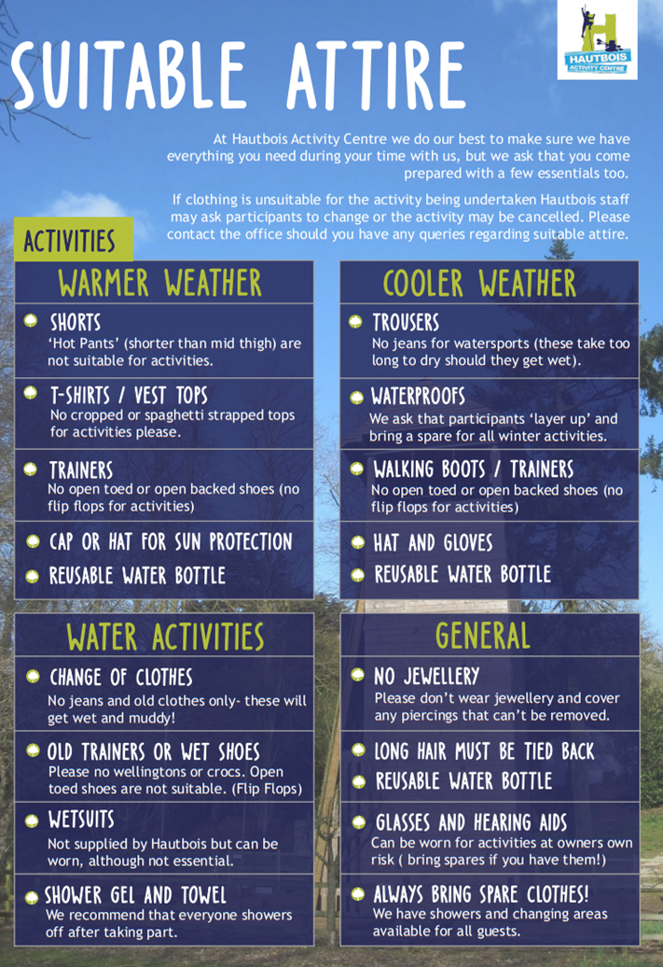
What to Pack:
Notes:
We are going to focus on ratio more than proportion today.
First, let’s recap!
Independently on your whiteboards

Slide 8
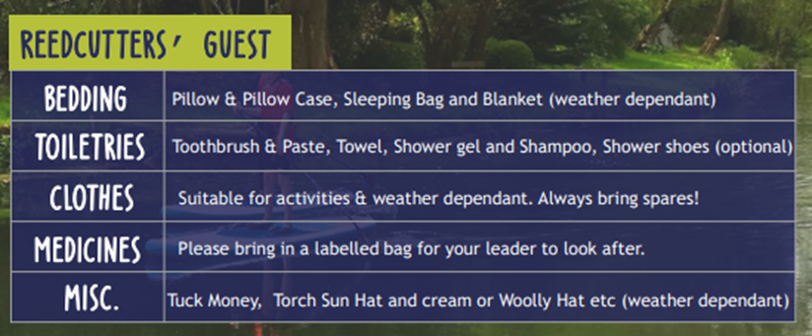
What to Pack:
Notes:
We are going to focus on ratio more than proportion today.
First, let’s recap!
Independently on your whiteboards

Slide 9
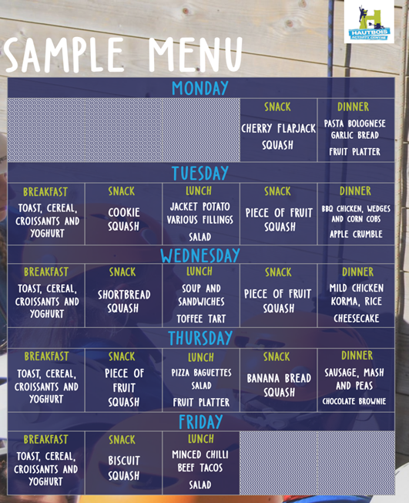
Catering:
Although we had a choice to cater for food ourselves, we opted to be catered for during this trip which is already included in the price. For guests being catered for by Hautbois Activity Centre, meals will be served from the large dining marquee near the house, leaving your marquee free for participant use throughout the day.
Notes:
We are going to focus on ratio more than proportion today.
First, let’s recap!
Independently on your whiteboards

Slide 10
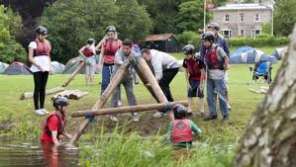
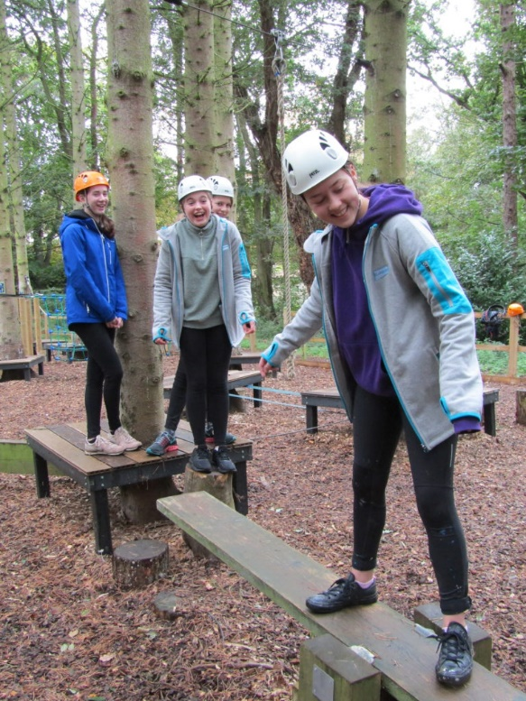
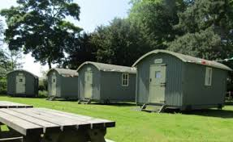
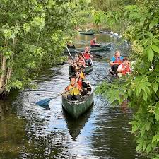
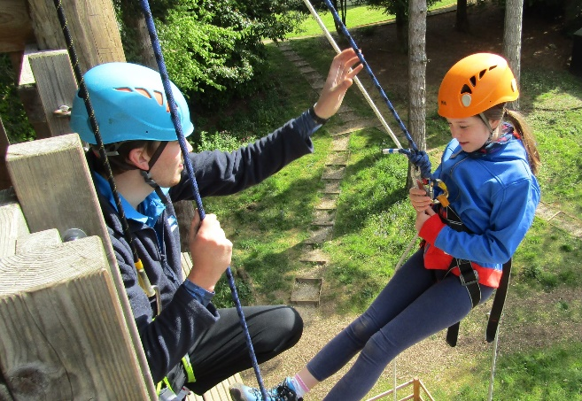
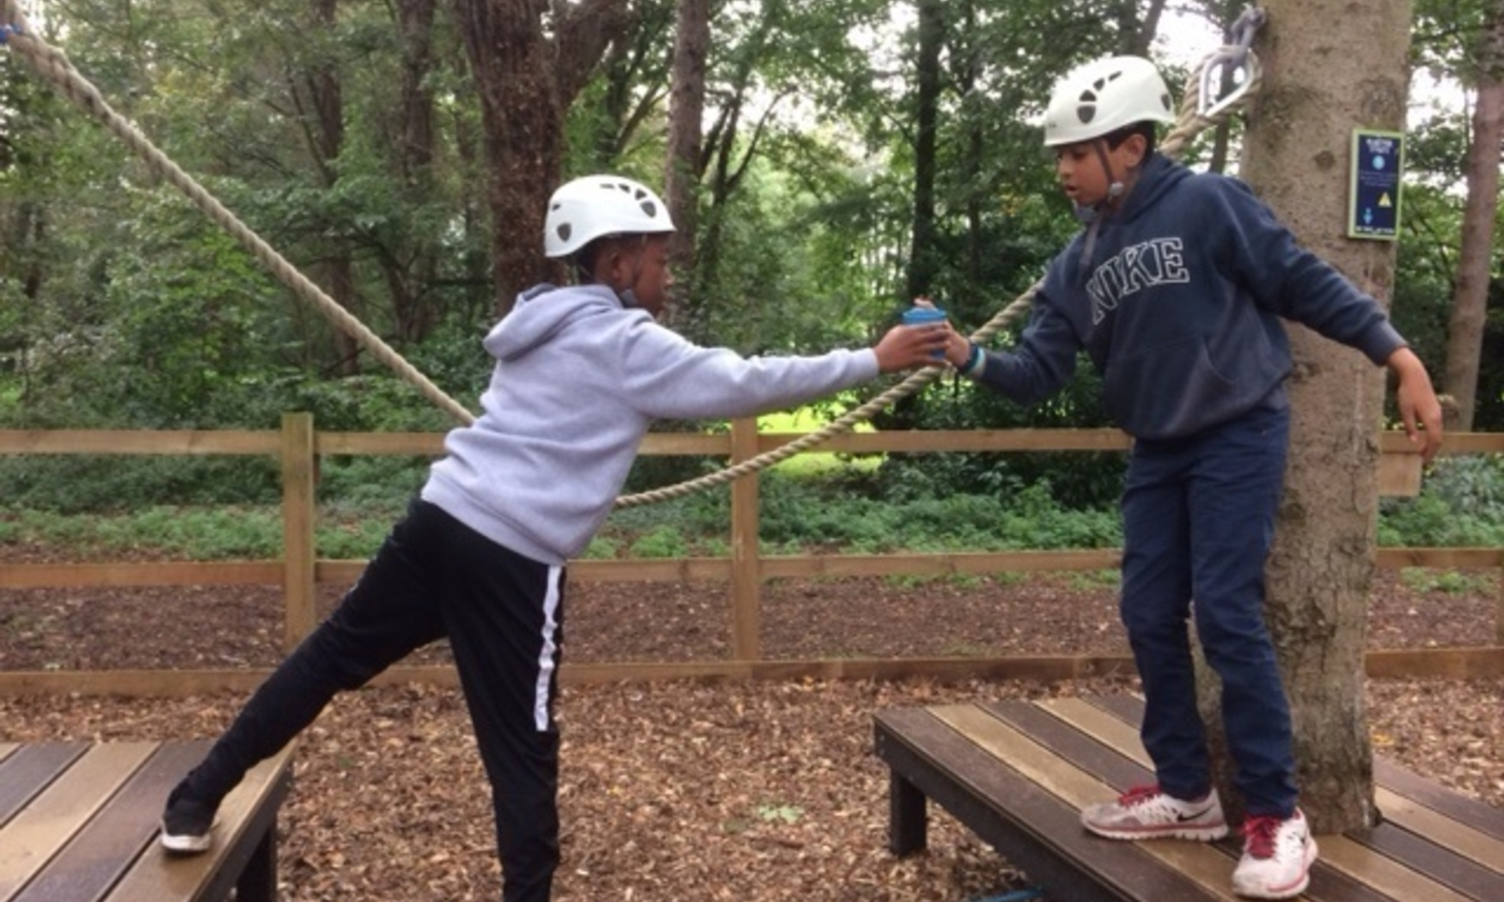
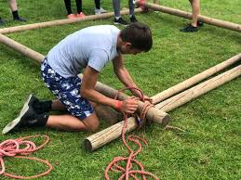
Activities:
Notes:
We are going to focus on ratio more than proportion today.
First, let’s recap!
Independently on your whiteboards

Slide 11
Cost:
Hautbois activities; accommodation; travel costs; full board catering; evening additional events and 24 hour care for 4 days and 3 nights during high season:
£360 per child
Initial deposit = £30 by Friday 1st December 2023
2nd payment = £110 by Monday 29th January 2024
3rd payment = £110 by Monday 26th February 2024
Final payment = £110 by Friday 29th March 2024
*If your child is eligible for FSM please come and speak to me.
*If your child is eligible for PP please come and speak to me.
If you would like your child to go, you will need to pay an initial £30 deposit per child via SCOPAY by Friday 1st December 2023. You will then need to pay the instalments listed below. Alternatively, you can pay the whole amount, £360, in one go. All payments should be made using the SCOPAY system that you use for school lunches and other school expenses.
You should be aware that any payments made are non-refundable, as we are contractually committed to pay Hautbois Activity Centre as well as the coach company. In the unlikely event that your child was seriously ill during the week of the residential, the school would try to negotiate with Hautbois Activity Centre for a refund on your behalf.
Notes:
We are going to focus on ratio more than proportion today.
First, let’s recap!
Independently on your whiteboards

Slide 12
Actions:
Day of arrival (25th June 2024):
The exact programme of activities that the children will undertake is still being finalised and it will differ from past residential that the school has taken. I can confirm that we intend to have:
Games evening
Cinema evening
Disco evening
All specialist activities are led by fully qualified instructors.
We will be holding another parents’ meeting nearer to the time of the residential visit, explaining all of the final arrangements for the visit, such as sleeping, kit lists, the daily routine, medical and dietary needs, etc. You will also be sent letters giving further details, together with any forms that you have to fill out on behalf of the school.
We are meeting this early in the year to give parents the maximum time to spread payments over the coming months. As you will appreciate, week’s food and accommodation, together with instructors for the daily activities makes this kind of visit significantly more expensive than our usual school trips. If you have any concerns over being able to pay for the residential, please come and speak to me.
Notes:
We are going to focus on ratio more than proportion today.
First, let’s recap!
Independently on your whiteboards

Slide 13
Final Word:
This is a fantastic opportunity for your child to experience and I do hope they will be able to come. However, I realise that they/you may have concerns, such as sleepwalking, bedwetting, medical needs, or just that they have never stayed away from home before. If you would like to discuss any concerns that you have before making a final decision, then please come and see me.
Notes:
We are going to focus on ratio more than proportion today.
First, let’s recap!
Independently on your whiteboards

Slide 14
Thank you for listening Any Questions?
Notes:
We are going to focus on ratio more than proportion today.
First, let’s recap!
Independently on your whiteboards

