Slide 1
Phonics at Ashdon
Thursday 9th November 2023
Notes:
We are going to focus on ratio more than proportion today.
First, let’s recap!
Independently on your whiteboards

Slide 2
Teach a child to read and keep that child reading and we will change everything.
And I mean everything.
Jeanette Winterson
Notes:
We are going to focus on ratio more than proportion today.
First, let’s recap!
Independently on your whiteboards

Slide 3
What are we doing at Ashdon?
Notes:
We are going to focus on ratio more than proportion today.
First, let’s recap!
Independently on your whiteboards

Slide 4
Currently:
Daily phonics lessons from Reception to Year 2 - following the Monster Phonics programme
These sessions are taught in small groups in their year groups at first
Once we see progress or a lack of progress, we stream the children into the most appropriate ability group
They go through the grapheme-phoneme-correspondence (which letters/group of letters make what sound)
They decode (spotting the ‘special friends’; sounding out the word and blending it together
They learn which monsters make which sounds and link the connection between the two
They read texts, identifying the sounds they have learned and successfully read words with these sounds in them
They read HFW or regular words from flash cards and books (was, is, the etc.)
Phonics interventions late mornings and in the afternoons
Notes:
We are going to focus on ratio more than proportion today.
First, let’s recap!
Independently on your whiteboards

Slide 5
Changes for 2023-2024:
We must ensure that pupils are in the correct progression groups; are assessed half termly; that staff have regular CPD and that teaching and learning are monitored for Phonics.
Some pupils might be in a different group to their year group to better support their needs at that point in time.
Adjustments to groups are made half termly.
Staff will have regular training from the phonics lead/Monster Phonics team for staff to continue having high expectations in phonics
We will also schedule some parent workshops in order for parents to have a very clear understanding of what we do and what they can do to better support their child learning phonics at home as well
We will have half termly assessments, and analyse the data to make informed decisions about groupings
Notes:
We are going to focus on ratio more than proportion today.
First, let’s recap!
Independently on your whiteboards

Slide 6
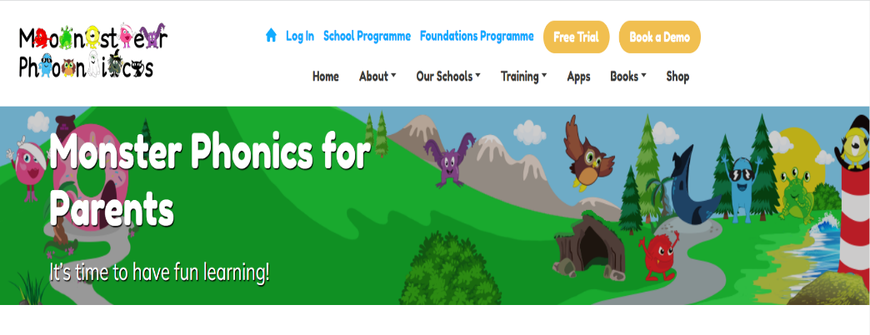
What can you do to help?
Let your child see you read and also read to them everyday
Tell your child about interesting things that you have read in newspapers, magazines , books and on the internet
Visit the local library and bookshops
Engage with reading (books sent home):
talk about the story
ask questions about the characters, plot and setting
retell the story
interesting words/key vocabulary
make a comment in their reading record about their reading
Visit the Monster Phonics Website and sign up:
https://monsterphonics.com/monster-phonics-for-parents/
https://monsterphonics.com/games/ (apps – games)
Notes:
We are going to focus on ratio more than proportion today.
First, let’s recap!
Independently on your whiteboards

Slide 7
Year 1 Phonics Screening Check - Key Information:
The phonics screening check is a statutory assessment for all pupils in Year 1. It is usually administered during June of the year they are in Yr 1.
It will be administered from Monday 3rd June until Friday 14th June 2023. by Ms. Reynecke
It comprises of a list of 40 words (20 real and 20 nonsense/alien words)
The government’s expectation in the past were that pupils should achieve around 32/40 to reach the expected level (Please note: This is subject to change and might be even up to 36 out of 40)
The phonics screening check will take up to 15 minutes per pupil
Pupils who do not achieve the expected level must be considered for a retake in June 2024 with the current Year 1 pupils
Year 2 pupils will continue with phonics lessons for the rest of the year and those pupils that complete the Monster Phonics programme will take part in other planned reading sessions
The aim is to achieve at least 80% this year, however, I would like to aim higher for the year 2023-2024. We will do this through more rigorous training for staff and more consistent assessments, adaptations and interventions for our pupils.
The earlier you start helping your child at home the more prepared they are for the PSC in Year 1 and can read with more fluency during the KS1 SATs reading paper.
Notes:
We are going to focus on ratio more than proportion today.
First, let’s recap!
Independently on your whiteboards

Slide 8
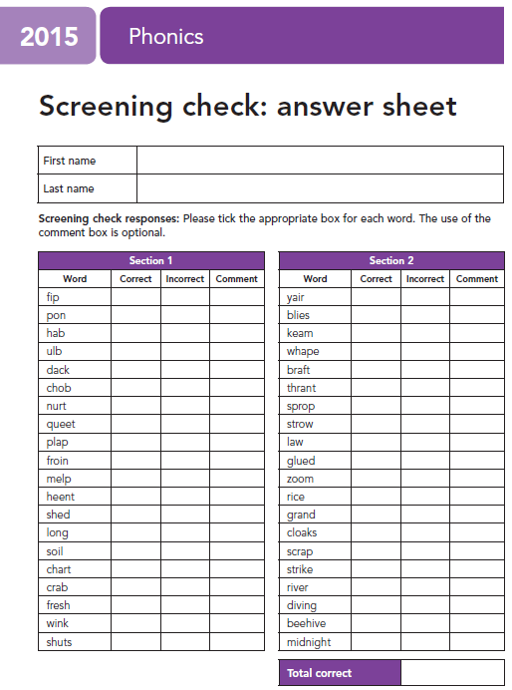
What does the tests look like?
This is the sheet the teacher
will use to assess the child
Notes:
We are going to focus on ratio more than proportion today.
First, let’s recap!
Independently on your whiteboards

Slide 9
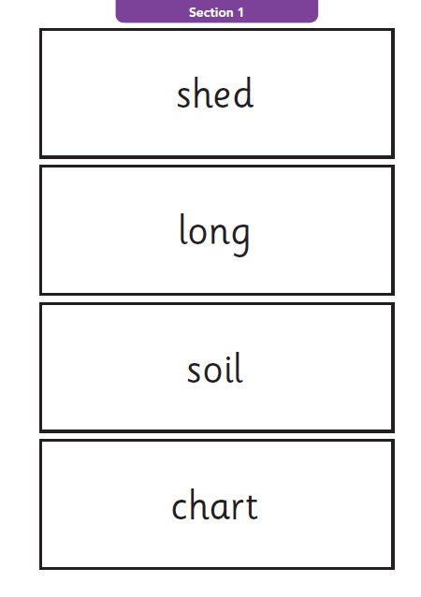
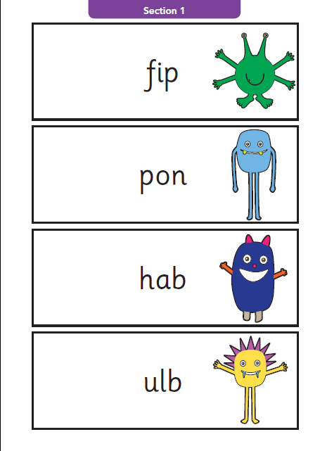
What does the tests look like for our pupils?
Section 1:
Slightly easier
Notes:
We are going to focus on ratio more than proportion today.
First, let’s recap!
Independently on your whiteboards

Slide 10
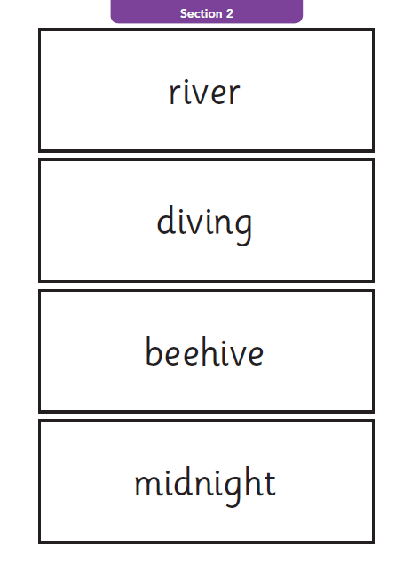
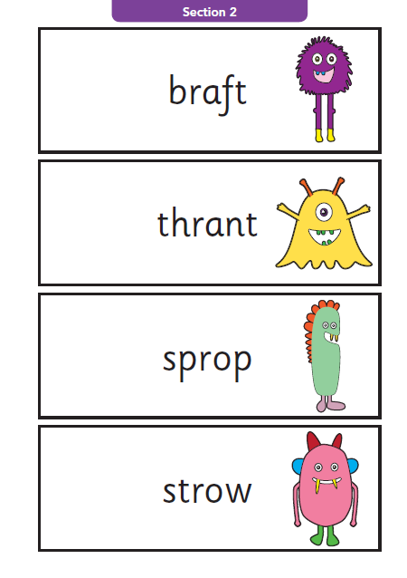
What does the tests look like for our pupils?
Section 2:
A bit trickier
Notes:
We are going to focus on ratio more than proportion today.
First, let’s recap!
Independently on your whiteboards

Slide 11
Data:
Year | Ashdon’s Last Pass Rate | National Rate
2021-2022 (no figures available as it was not published) Last data published was 2019 | 86% | 75%
2022-2023 | 100% | 81%
Notes:
We are going to focus on ratio more than proportion today.
First, let’s recap!
Independently on your whiteboards

Slide 12
Additional Information:
www.gov.uk
Search:
‘Phonics Screening Check’
Year 1 Phonics screening check past papers from
2012-2022
Notes:
We are going to focus on ratio more than proportion today.
First, let’s recap!
Independently on your whiteboards

Slide 13
Thank you for listening If you have further questions please speak to your child’s class teacher
Notes:
We are going to focus on ratio more than proportion today.
First, let’s recap!
Independently on your whiteboards

